Slide 1
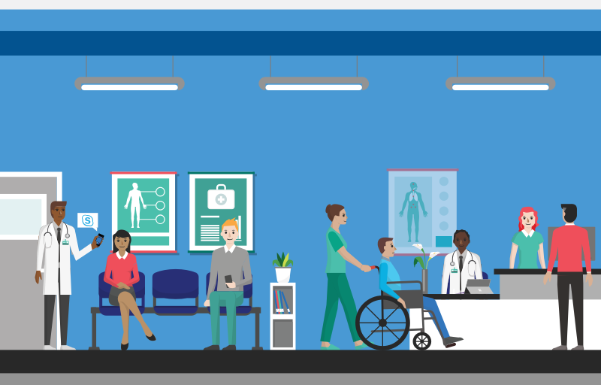
MEDTECH

Slide 2
Problem Statement-Needs Identified
Time is very important.
To know the best hospital.
Waiting for long hours.
Long waits increase patients length of stay.
This has to be addressed by reducing the wait time.
Habituated to pills.
No knowledge of home remedy.

Slide 3
Damaged organs reduce life time.
So organ transplantation is required.
Required for scientific and medical research.
Develop new technologies.
Cure diseases.

Slide 4
Objectives-Use Cases
This project is aimed to give the users
immediate response to their health issue.
1. To book an appointment:
User who want to book an appointment will get a list of nearby hospitals through which he can choose his desired hospital and book an appointment.

Slide 5
After booking the appointment a token number will be generated
Through the token number user can track the waiting time and approximate reporting time.
User will also be notified before his/her turn comes up.
Feedback will also be taken by the user
In case user mentions any loopholes they would be addressed.

Slide 6
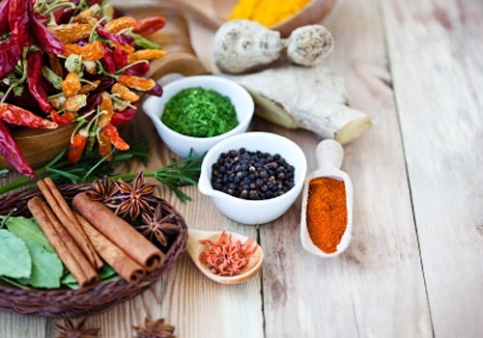
2. Home Remedies:
A Home remedy is defined as simply prepared
medication or tonic often of unproven
effectiveness administered without prescription
or professional supervision.

Slide 7
If user requires a home remedy instead of consulting a doctor or to avoid tablets.
He/she approaches the website and reports the problem .
Then a solution will be provided to address the problem.

Slide 8
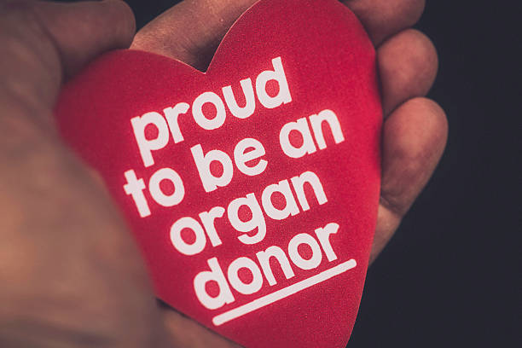
3. Organ Donation:
It is the process of surgically removing an organ from a person’s body and placing it into another person’s body.

Slide 9
If the user would wish to donate his/her
organs they can place their information in
the website, then we will suggest them the
best hospitals in the city which are a part
of organ transplantation.

Slide 10
Technologies used
The whole application will be implemented using Django.
HTML,CSS will be used.
Validations would be done JavaScript.

Slide 11
THANK YOU
BY
S.SHREYA
Y.RAKESH
A.VARSHA

